Slide 1
Agenda
Definition
Why Computers
History of Computers
Hardware
Software

Slide 2
Introduction to Computers
The term computer is derived from the word compute. The word compute means to calculate.
A computer is an electronic machine that accepts data from the user, processes the data by performing calculations and operations on it, and generates the desired output results.
Computer performs both simple and complex operations, with speed and accuracy.

Slide 3
Types of Computers
Digital Computers
Analog Computers
Digital Computers:
A digital computer uses distinct values to represent the data internally. All information are represented using the digits Os and 1s.
The computers that we use at our homes and offices are digital computers.
Analog Computers:
Analog computer is another kind of a computer that represents data as variable across a continuous range of values.
The earliest computers were analog computers.
Analog computers are used for measuring of parameters that vary continuously in real time, such as temperature, pressure and voltage.
Analog computers may be more flexible but generally less precise than digital computers. Slide rule is an example of an analog computer.

Slide 4
History of Computers
The first counting device was used by the primitive people. They used sticks, stones and bones as counting tools.
As human mind and technology improved with time more computing devices were developed.
Some of the popular computing devices starting with the first to recent ones are described below;
Generations of Computers
A generation of computers refers to the specific improvements in computer technology with time. In 1946, electronic pathways called circuits were developed to perform the counting.
It replaced the gears and other mechanical parts used for counting in previous computing machines.

Slide 5
In each new generation, the circuits became smaller and more advanced than the previous generation circuits.
The miniaturization helped increase the speed, memory and power of computers.
There are five generations of computers
First Generation
Second Generation
Third Generation
Fourth Generation
Fifth Generation

Slide 6
First Generation:
The first generation (1946-1959) computers were slow, huge and expensive.
In these computers, vacuum tubes were used as the basic components of CPU and memory.
These computers were mainly depended on batch operating system and punch cards.
Magnetic tape and paper tape were used as output and input devices in this generation;
Some of the popular first generation computers are;
ENIAC ( Electronic Numerical Integrator and Computer)
EDVAC ( Electronic Discrete Variable Automatic Computer)
UNIVACI( Universal Automatic Computer)
IBM-701
IBM-650

Slide 7
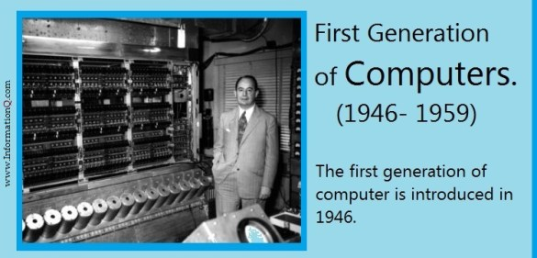
First Generation

Slide 8
Second Generation
The second generation (1959-1965) was the era of the transistor computers.
These computers used transistors which were cheap, compact and consuming less power; it made transistor computers faster than the first generation computers.
In this generation, magnetic cores were used as the primary memory and magnetic disc and tapes were used as the secondary storage.
Assembly language and programming languages like COBOL and FORTRAN, and Batch processing and multiprogramming operating systems were used in these computers.
Some of the popular second generation computers are
IBM 1620
IBM 7094
CDC 1604
CDC 3600

Slide 9
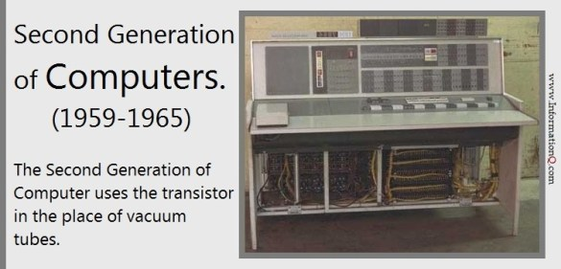
Second Generation

Slide 10
Third Generation
The third generation computers used integrated circuits (ICs) instead of transistors. A single IC can pack huge number of transistors which increased the power of a computer and reduced the cost.
The computers also became more reliable, efficient and smaller in size. These generation computers used remote processing, time-sharing, multi programming as operating system.
Also, the high-level programming languages like FORTRON-II TO IV, COBOL, PASCAL PL/1, ALGOL-68 were used in this generation.
Some of the popular third generation computers are;
IBM-360 series
Honeywell-6000 series
PDP(Personal Data Processor)
IBM-370/168
TDC-316

Slide 11
Third Generation

Slide 12
Fourth Generation
The fourth generation (1971-1980) computers used very large scale integrated (VLSI) circuits; a chip containing millions of transistors and other circuit elements.
These chips made this generation computers more compact, powerful, fast and affordable.
These generation computers used real time, time sharing and distributed operating system.
The programming languages like C, C++, DBASE were also used in this generation
Some of the popular fourth generation computers are
DEC 10
STAR 1000
PDP 11
CRAY-1(Super Computer)
CRAY-X-MP(Super Computer)
.

Slide 13
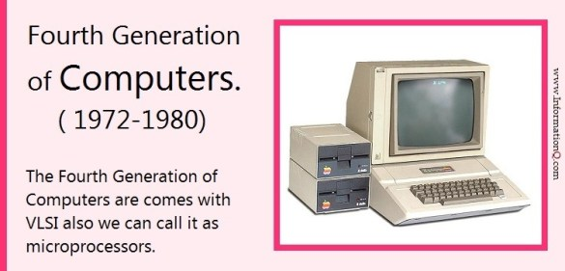
Fourth Generation

Slide 14
Fifth Generation
In fifth generation (1980-till date) computers, the VLSI technology was replaced with ULSI (Ultra Large Scale Integration).
It made possible the production of microprocessor chips with ten million electronic components. This generation computers used parallel processing hardware and AI (Artificial Intelligence) software.
The programming languages used in this generation were C, C++, Java, . Net, etc.
Some of the popular fifth generation computers are;
Desktop
Laptop
Note Book
Ultra Book
Chrome Book

Slide 15
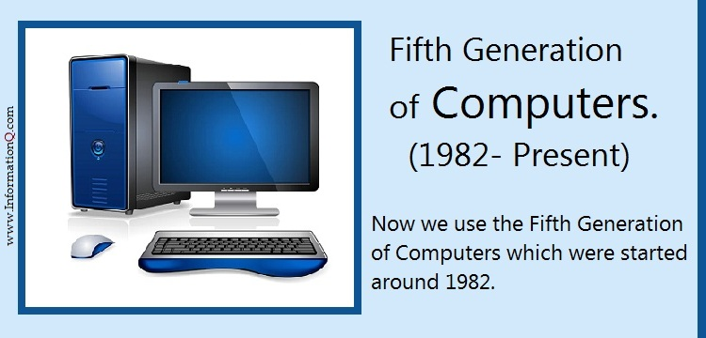
Fifth Generation

Slide 16
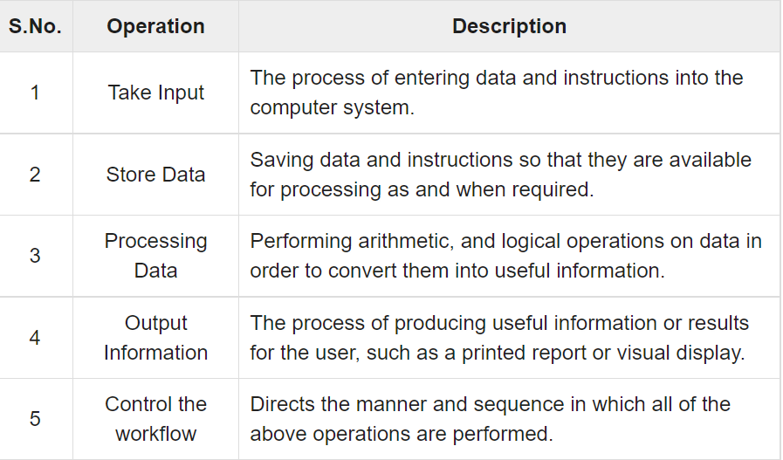
Computer Fundamentals
All types of computers follow the same basic logical structure and perform the following five basic operations for converting raw input data into information useful to their users.

Slide 17
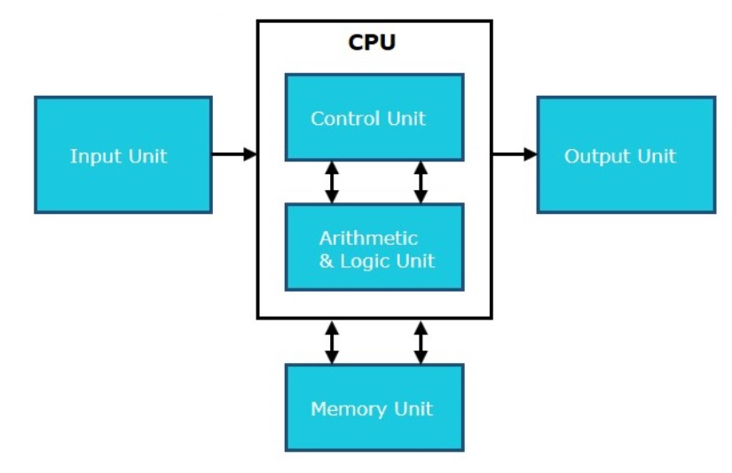
Basic Logic Structure(basic organization of digital computer)

Slide 18
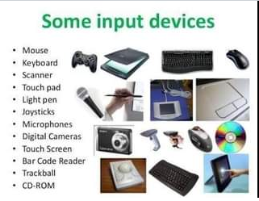
Input Unit
This unit contains devices with the help of which we enter data into the computer. This unit creates a link between the user and the computer. The input devices translate the information into a form understandable by the computer. Ex Mouse, light pen, Joystick, Scanner, keyboard, web cam,

Slide 19
CPU(Central Processing Unit)
Central Processing Unit (CPU) consists of the following features −
CPU is considered as the brain of the computer.
CPU performs all types of data processing operations.
It stores data, intermediate results, and instructions (program).
It controls the operation of all parts of the computer.
CPU it has following three components.
ALU(Arithmetic Logic Unit)
Control Unit
Memory or Storage Unit

Slide 20
ALU( arithmetic logic unit)
(ALU) is a digital circuit used to perform arithmetic and logic operations.
It represents the fundamental building block of the central processing unit (CPU) of a computer.
Modern CPUs contain very powerful and complex ALUs.
In addition to ALUs, modern CPUs contain a control unit (CU).
Most of the operations of a CPU are performed by one or more ALUs, which load data from input registers.
A register is a small amount of storage available as part of a CPU.
The control unit tells the ALU what operation to perform on that data, and the ALU stores the result in an output register.
The control unit moves the data between these registers, the ALU, and memory.
An ALU performs basic arithmetic and logic operations.
Examples of arithmetic operations are: addition, subtraction, multiplication, and division.
Examples of logic operations are :comparisons of values such as NOT, AND, and OR.

Slide 21
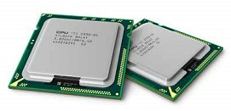
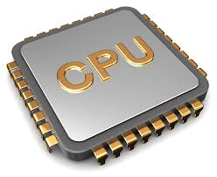
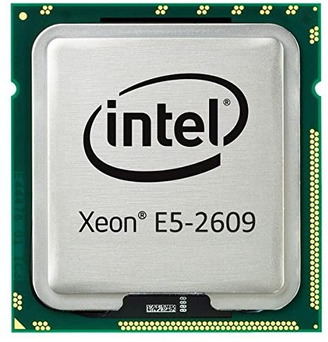
Processor
Types of processor
1) Single-core CPU
2) Dual-core CPU
3) Quad-core CPU
4) Quad-core CPU
5) Hexa -Core processors
6) Octa -core processors
7) Deca -core processor
Ex: Intel core i3,i5,i7 & i9
Intel is launched with Inter core i7 in 2010 with Hexa core processor.

Slide 22
Control Unit
A control unit or CU is circuitry that directs operations within a computer's processor.
It lets the computer's logic unit, memory, and both input and output devices know how to respond to instructions received from a program.
Examples of devices that utilize control units include CPUs and GPUs.
A control unit works by receiving input information that it converts into control signals, which are then sent to the central processor.
The computer's processor then tells the attached hardware what operations to carry out. The functions that a control unit performs are dependent on the type of CPU, due to the variance of architecture between different manufacturers.
Functions of the Control Unit –
It coordinates the sequence of data movements into, out of, and between a processor’s many sub-units.
It interprets instructions.
It controls data flow inside the processor.
It receives external instructions or commands to which it converts to sequence of control signals.
It controls many execution units(i.e. ALU, data buffers and registers) contained within a CPU.
It also handles multiple tasks, such as fetching, decoding, execution handling and storing results.

Slide 23
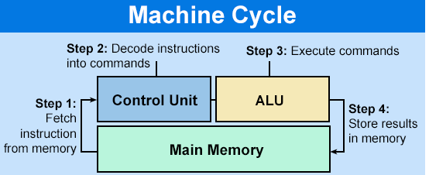

Slide 24
Memory or Storage Unit
This unit can store instructions, data, and intermediate results. This unit supplies information to other units of the computer when needed.
It is also known as internal storage unit or the main memory or the primary storage or Random Access Memory (RAM).
Its size affects speed, power, and capability
Three types of memories in the computer.
Cache Memory
Primary memory
secondary memory
Functions of the memory unit are −
It stores all the data and the instructions required for processing.
It stores intermediate results of processing.
It stores the final results of processing before these results are released to an output device.
All inputs and outputs are transmitted through the main memory.

Slide 25
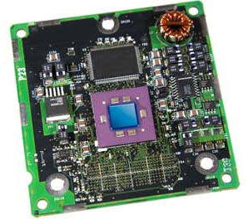
Cache Memory
Cache memory is a very high speed semiconductor memory which can speed up the CPU.
It acts as a buffer between the CPU and the main memory.
It is used to hold those parts of data and program which are most frequently used by the CPU.
the parts of data and programs are transferred from the disk to cache memory by the operating system, from where the CPU can access them.

Slide 26
Advantages
The advantages of cache memory are as follows −
Cache memory is faster than main memory.
It consumes less access time as compared to main memory.
It stores the program that can be executed within a short period of time.
It stores data for temporary use.
Disadvantages
The disadvantages of cache memory are as follows −
Cache memory has limited capacity.
It is very expensive.

Slide 27
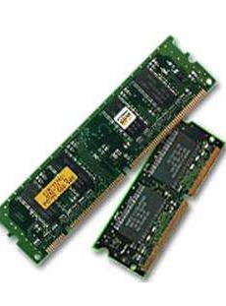
Primary Memory (Main Memory)
Primary memory holds only those data and instructions on which the computer is currently working.
It has a limited capacity and data is lost when power is switched off. It is generally made up of semiconductor device. These memories are not as fast as registers.
The data and instruction required to be processed resides in the main memory. It is divided into two subcategories RAM and ROM.

Slide 28
Characteristics of Main Memory
These are semiconductor memories.
It is known as the main memory.
Usually volatile memory.
Data is lost in case power is switched off.
It is the working memory of the computer.
Faster than secondary memories.
A computer cannot run without the primary memory.

Slide 29
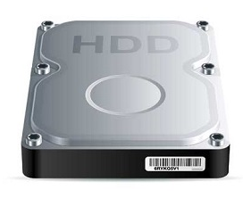
Secondary Memory
This type of memory is also known as external memory or non-volatile.
It is slower than the main memory.
These are used for storing data/information permanently.
CPU directly does not access these memories, instead they are accessed via input-output routines.
he contents of secondary memories are first transferred to the main memory, and then the CPU can access it. For example, disk, CD-ROM, DVD, etc.

Slide 30
Characteristics of Secondary Memory
These are magnetic and optical memories.
It is known as the backup memory.
It is a non-volatile memory.
Data is permanently stored even if power is switched off.
It is used for storage of data in a computer.
Computer may run without the secondary memory.
Slower than primary memories.

Slide 31
Advantages of Computers
High Speed
Computer is a very fast device.
It is capable of performing calculation of very large amount of data.
The computer has units of speed in microsecond, nanosecond, and even the picoseconds.
It can perform millions of calculations in a few seconds as compared to man who will spend many months to perform the same task.
Accuracy
In addition to being very fast, computers are very accurate.
The calculations are 100% error free.
Computers perform all jobs with 100% accuracy provided that the input is correct.

Slide 32
Storage Capability
Memory is a very important characteristic of computers.
A computer has much more storage capacity than human beings.
It can store large amount of data.
It can store any type of data such as images, videos, text, audio, etc.
Diligence (effort)
Unlike human beings, a computer is free from monotony(lack of interest), tiredness, and lack of concentration.
It can work continuously without any error and boredom.
It can perform repeated tasks with the same speed and accuracy.

Slide 33
Versatility
A computer is a very versatile machine.
A computer is very flexible in performing the jobs to be done.
This machine can be used to solve the problems related to various fields.
At one instance, it may be solving a complex scientific problem and the very next moment it may be playing a card game.
Reliability
A computer is a reliable machine.
Modern electronic components have long lives.
Computers are designed to make maintenance easy.

Slide 34
Automation
Computer is an automatic machine.
Automation is the ability to perform a given task automatically.
Once the computer receives a program i.e., the program is stored in the computer memory, then the program and instruction can control the program execution without human interaction.
Reduction in Paper Work and Cost
The use of computers for data processing in an organization leads to reduction in paper work and results in speeding up the process.
As data in electronic files can be retrieved as and when required, the problem of maintenance of large number of paper files gets reduced.
Though the initial investment for installing a computer is high, it substantially reduces the cost of each of its transaction.

Slide 35
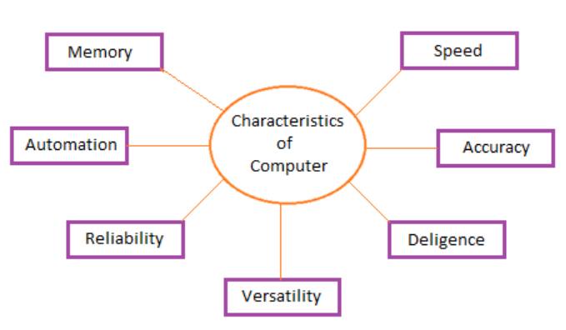
Characteristics Of computer

Slide 36
Disadvantages of Computers
Dependency
It functions as per the user’s instruction, thus it is fully dependent on humans.
Environment
The operating environment of the computer should be dust free and suitable.
No Feeling
Computers have no feelings or emotions.
It cannot make judgment based on feeling, taste, experience, and knowledge unlike humans.

Slide 37
Types of Computers
All the computers that are developed are not alike rather they have different designs and features.
Some computers have very high capacity as well as working speed however, some are slow.
Depending upon the requirements, computers are being developed.
Mainframe Computer
It is high capacity and costly computer. It is largely used by big organizations where many people can use it simultaneously.
Super Computer
This category of computer is the fastest and also very expensive. A typical supercomputer can solve up to ten trillion individual calculations per second.
Workstation Computer
The computer of this category is a high-end and expensive one. It is exclusively made for complex work purpose.

Slide 38
Personal Computer (PC)
It is a low capacity computer developed for single users.
Apple Macintosh (Mac)
It is a sort of personal computer manufactured by Apple company.
Laptop computer (notebook)
It is a handy computer that can be easily carried anywhere.
Tablet and Smartphone
Modern technology has advanced further. It has helped develop computers that are pocket-friendly. Tablets and smartphones are the best examples of such computer.

